Slide 1
Unit 1: OOP
Prepared By:
Aiysha Siddiqui
Asst. Prof. (CSA)

Slide 2
Contents
Introduction to OOP
Classes and Object
Defining a class in Python
Creating a object in Python
OOPS concept in Python

Slide 3
Introduction to OOP
Object-oriented programming System (OOPs) is a programming paradigm based on the concept of “objects” that contain data and methods.
The primary purpose of object-oriented programming is to increase the flexibility and maintainability of programs.
Object oriented programming brings together data and its behaviour (methods) in a single location (object) makes it easier to understand how a program works.
Object-Oriented Programming or OOPs refers to languages that use objects in programming.
The main aim of OOP is to bind together the data and the functions that operate on them so that no other part of the code can access this data except that function.

Slide 4
Class
A class is a user-defined data type. It consists of data members and member functions, which can be accessed and used by creating an instance of that class.
It represents the set of properties or methods that are common to all objects of one type. A class is like a blueprint for an object.
For Example: Consider the Class of Cars. There may be many cars with different names and brands but all of them will share some common properties like all of them will have 4 wheels, Speed Limit, Mileage range, etc. So here, Car is the class, and wheels, speed limits, mileage are their properties.

Slide 5
Class (cont..)
We can think of class as a sketch (prototype) of a house. It contains all the details about the floors, doors, windows etc. Based on these descriptions we build the house. House is the object.
As many houses can be made from a house's blueprint, we can create many objects from a class. An object is also called an instance of a class and the process of creating this object is called instantiation.

Slide 6
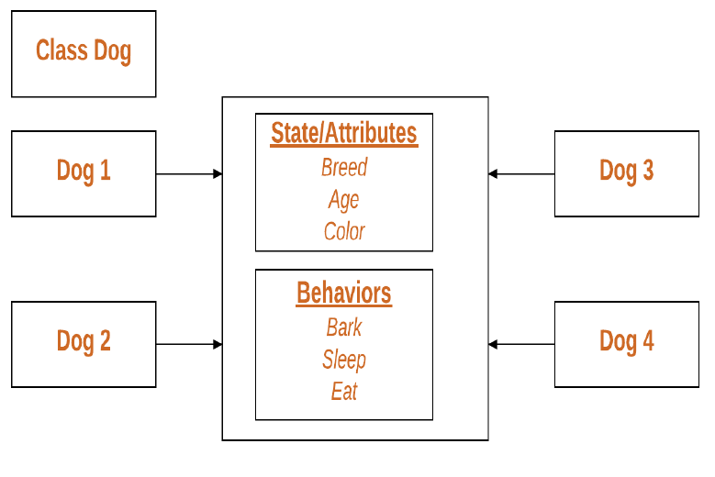

Slide 7
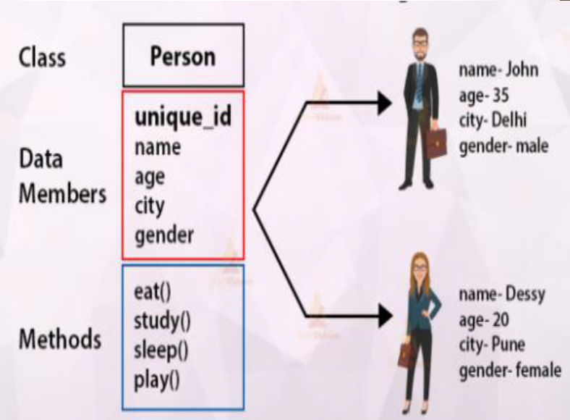

Slide 8
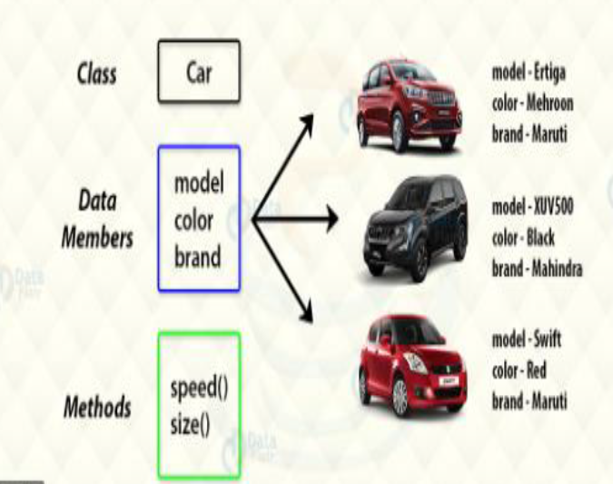

Slide 9
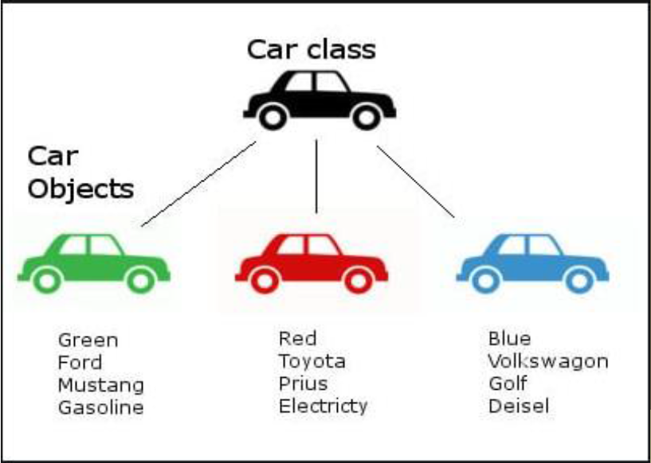

Slide 10
Object
It is a basic unit of Object-Oriented Programming and represents the real-life entities.
An Object is an instance of a Class. When a class is defined, no memory is allocated but when it is instantiated (i.e. an object is created) memory is allocated. An object has an identity, state, and behavior.
Each object contains data and code to manipulate the data. Objects can interact without having to know details of each other’s data or code, it is sufficient to know the type of message accepted and type of response returned by the objects.
For example “Dog” is a real-life Object, which has some characteristics like color, Breed, Bark, Sleep, and Eats.

Slide 11
What is an object?
Object: is a bundle of data and its behaviour(often known as methods).
Objects have two characteristics: They have states and behaviors.
Examples of states and behaviors Example 1: Object: House State: Address, Color, Area Behavior: Open door, close door
So if I had to write a class based on states and behaviours of House. I can do it like this: States can be represented as instance variables and behaviours as methods of the class. We will see how to create classes in the next section of this guide.

Slide 12
Object (cont..)
Example 2:
Let’s take another example
Object: Car
State: Color, Brand, Weight, Model
Behavior: Break, Accelerate, Slow Down, Gear change.
Note: As we have seen above, the states and behaviors of an object, can be represented by variables and methods in the class respectively.

Slide 13
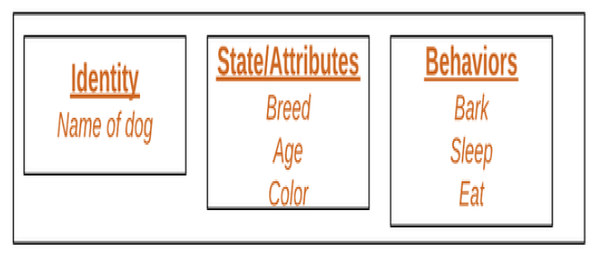

Slide 14
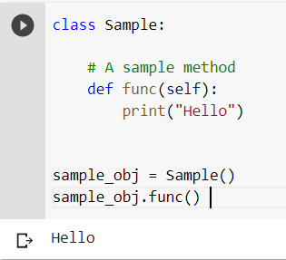
Class (Cont.)

Slide 15
The self Parameter
The self parameter is a reference to the current instance of the class, and is used to access variables that belongs to the class.
Class methods must have an extra first parameter in the method definition. We do not give a value for this parameter when we call the method.
If we have a method that takes no arguments, then we still have to define one argument – the self.
When we call a method of this object as myobject.method(arg1, arg2), this is automatically converted by Python into MyClass.method(myobject, arg1, arg2) – this is all the special self is about.

Slide 16
The __init__() Function
To understand the meaning of classes we have to understand the built-in __init__() function.
All classes have a function called __init__(), which is always executed when the class is being initiated.
Use the __init__() function to assign values to object properties, or other operations that are necessary to do when the object is being created.
It runs as soon as an object of a class is instantiated. The method is useful to do any initialization you want to do with your object.

Slide 17
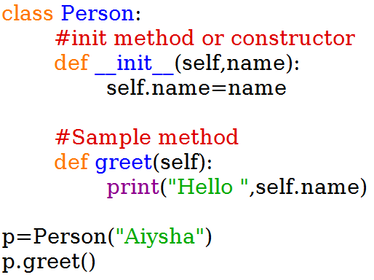
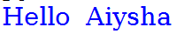
The __init__() Function (Cont.)
OUTPUT

Slide 18
Variables in OOP
Variables in a class are related to an object, to a class or to a method.
There are two different types of variables in OOPs.
Instance variable ( Object level variable )
Static variable ( Class level variable )

Slide 19
Variables in OOP
Class Variables — Declared inside the class definition (but outside any of the instance methods). They are not tied to any particular object of the class, hence shared across all the objects of the class. Modifying a class variable affects all objects instance at the same time. Also known as static variables.
Instance Variable — Declared inside the constructor method of class (the __init__ method). They are tied to the particular object instance of the class, hence the contents of an instance variable are completely independent from one object instance to the other.
Let’s start with a short and easy-to digest example:
class Car: wheels = 4 # <- Class variable
def __init__(self, name): self.name = name # <- Instance variable

Slide 20
Variables in OOP
In above example Car class is defined. Each instance of it will have class variable wheels along with the instance variable name.
>>> jag = Car('jaguar') >>> fer = Car('ferrari')
>>> jag.name, fer.name ('jaguar', 'ferrari')
>>> jag.wheels, fer.wheels (4, 4)
>>> Car.wheels 4

Slide 21
Variables in OOP (Summary)
We can declare instance variables:
Inside a constructor using self (shown above ).
Inside an Instance method.
Outside of the class using object reference.
Instance variables are created at the time of object creation and will be destroyed when it goes for Garbage collection.
For every object separate copy of instance variables will be created.
We can use __dict__ to know the instance variables and their corresponding values of an object. It returns values in a dictionary format.

Slide 22
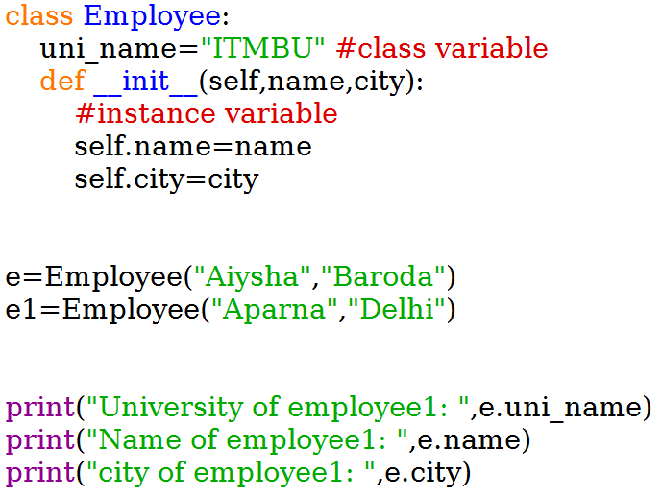
Example

Slide 23
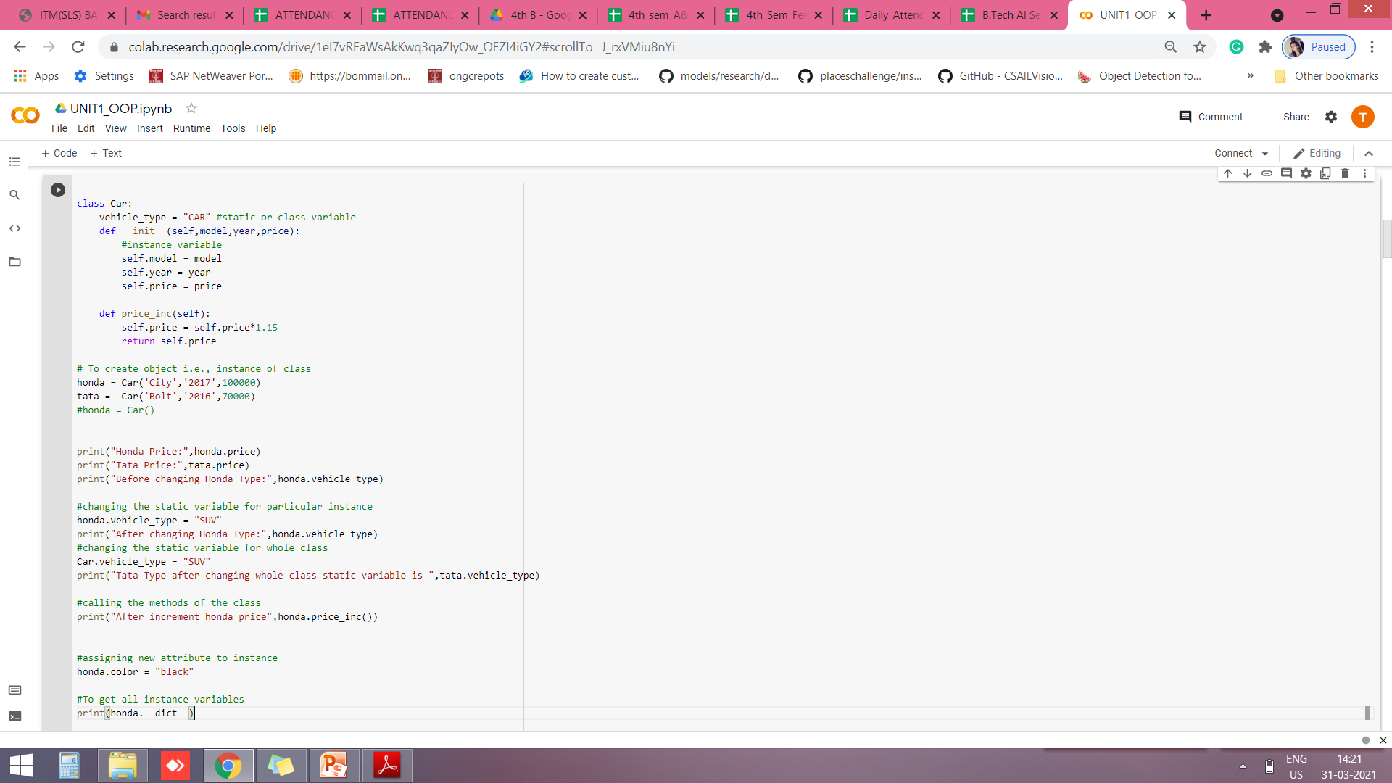
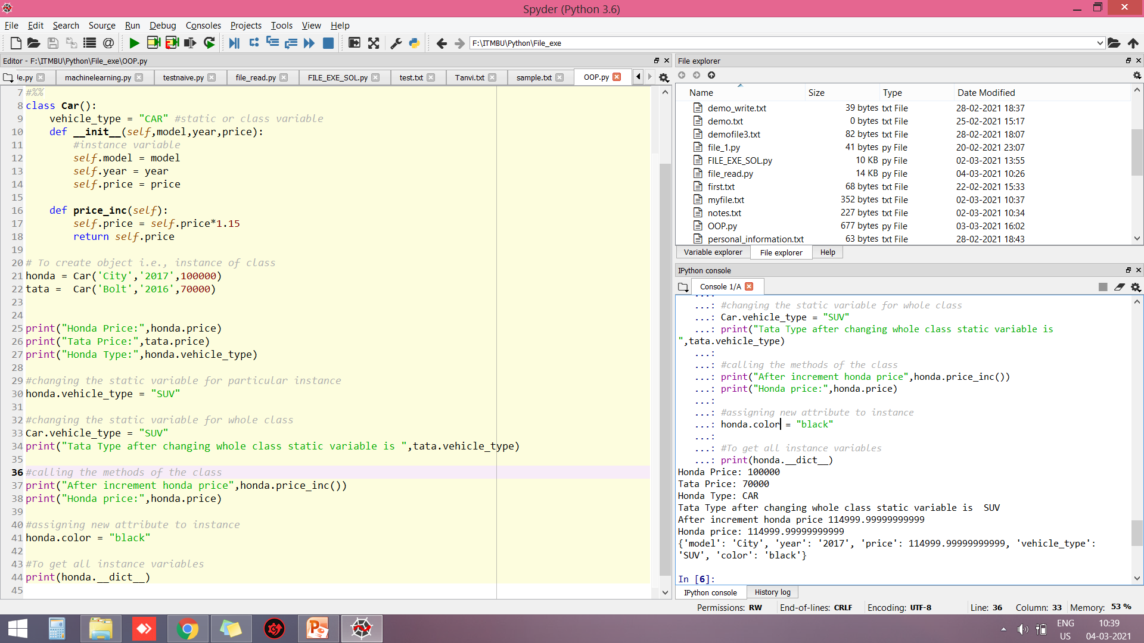
Example
Output:

Slide 24
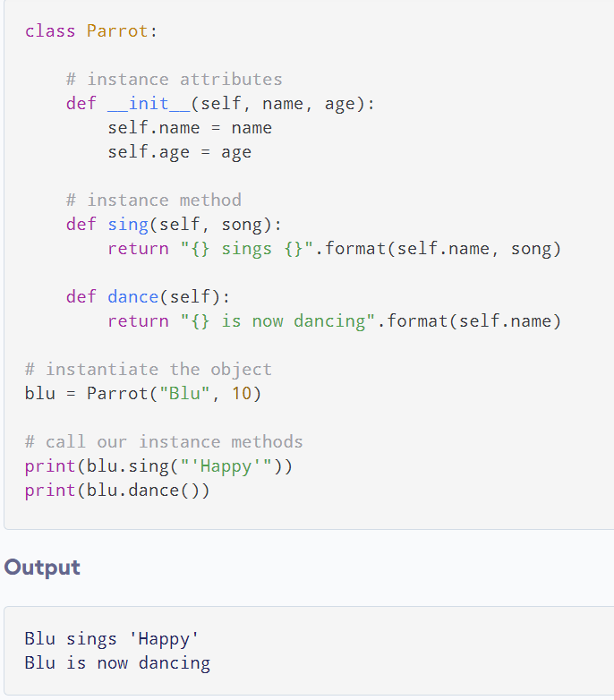
Example

Slide 25
Constructors in Python
Constructors are generally used for instantiating an object. The task of constructors is to initialize(assign values) to the data members of the class when an object of class is created. In Python the __init__() method is called the constructor and is always called when an object is created.
Syntax of constructor declaration :
def __init__(self):
# body of the constructor

Slide 26
Constructors in Python (Cont.)
Types of constructors :
Default constructor :The default constructor is simple constructor which doesn’t accept any arguments.I t’s definition has only one argument which is a reference to the instance being constructed.
Parameterized constructor :Constructor with parameters is known as parameterized constructor. The parameterized constructor take its first argument as a reference to the instance being constructed known as self and the rest of the arguments are provided by the programmer

Slide 27
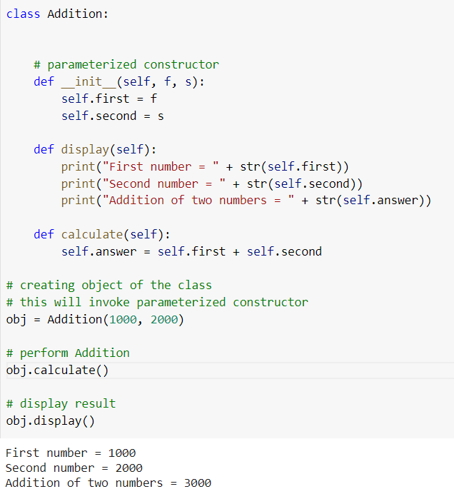
Constructors in Python (Cont.)

Slide 28
Destructors in Python
Destructors are called when an object gets destroyed. In Python, destructors are not needed as much because Python has a garbage collector that handles memory management automatically.
The __del__() method is a known as a destructor method in Python. It is called when all references to the object have been deleted i.e when an object is garbage collected.
Syntax of destructor declaration :
def __del__(self):
# body of destructor
Note : The destructor was called after the program ended or when all the references to object are deleted i.e when the reference count becomes zero, not when object went out of scope.

Slide 29
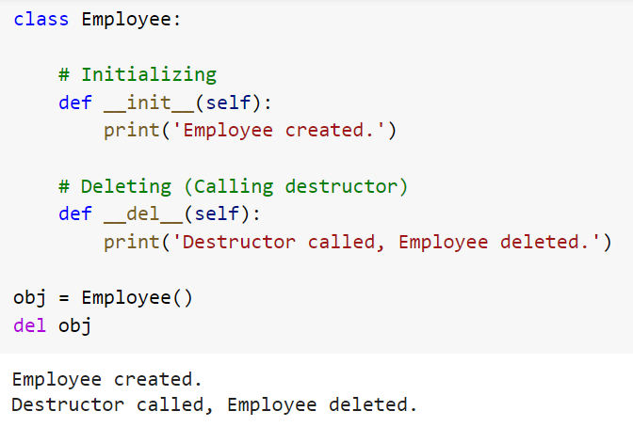
Destructors in Python (Cont.)

Slide 30
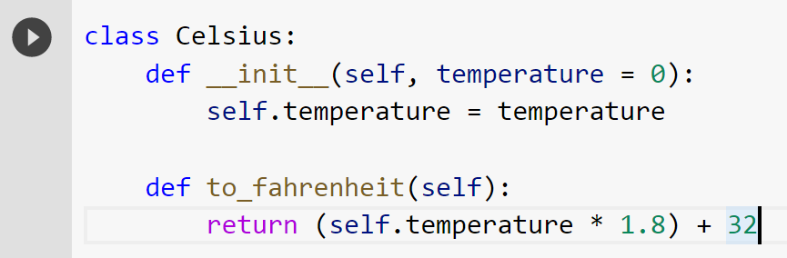
Methods for updating set...() and retrieving get...() of data members of the class
To make a class that stores the temperature in degrees Celsius. It would also implement a method to convert the temperature into degrees Fahrenheit. One way of doing this is as follows:

Slide 31
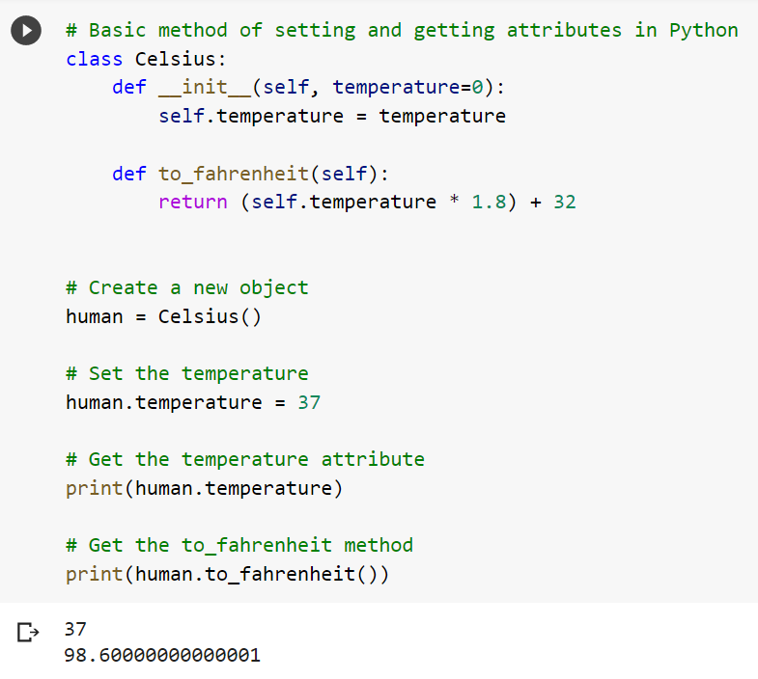
Methods for updating set...() and retrieving get...() of data members of the class
We can make objects out of this class and manipulate the temperature attribute as we wish:

Slide 32
Methods for updating set...() and retrieving get...() of data members of the class
Using Getters and Setters
Suppose we want to extend the usability of the Celsius class defined above. We know that the temperature of any object cannot reach below -273.15 degrees Celsius (Absolute Zero in Thermodynamics)
Let's update our code to implement this value constraint.
An obvious solution to the above restriction will be to hide the attribute temperature (make it private) and define new getter and setter methods to manipulate it. This can be done as follows:

Slide 33
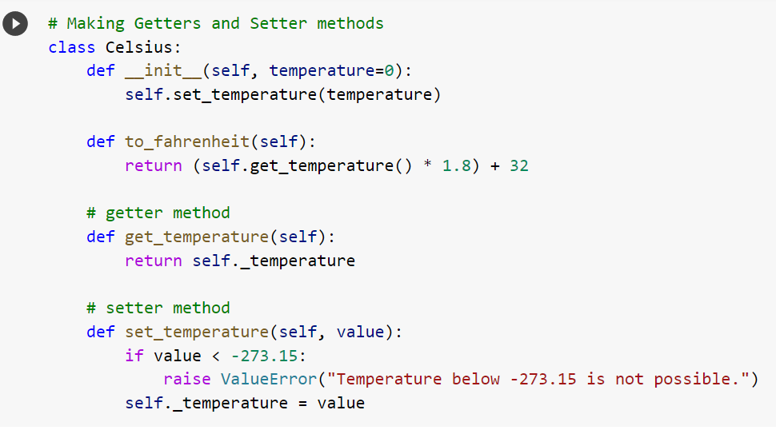
Methods for updating set...() and retrieving get...() of data members of the class

Slide 34
Methods for updating set...() and retrieving get...() of data members of the class
As we can see, the above method introduces two new get_temperature() and set_temperature() methods.
Furthermore, temperature was replaced with _temperature. An underscore _ at the beginning is used to denote private variables in Python.

Slide 35
OOPS CONCEPT IN PYTHON
Inheritance
Encapsulation
Abstraction
Polymorphism

Slide 36
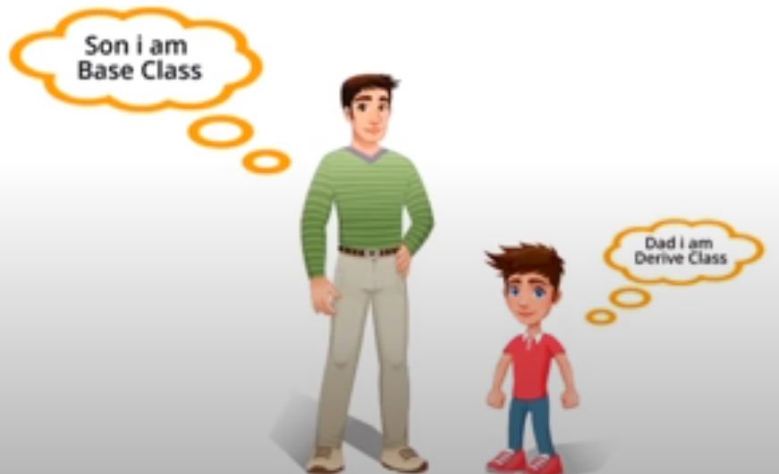
Inheritance
A class can inherit attributes and behaviour methods from another class, called superclass.
A class which inherits from a superclass is called subclass, also called their class or child class.
Inheritance

Slide 37
Inheritance (Cont.)
Inheritance is a way of creating a new class for using details of an existing class without modifying it.
It provides reusability of code. We don’t have to write the same code again and again. Also, it allows us to add more features to a class without modifying it.
It is transitive in nature, which means that if class B inherits from another class A, then all the subclasses of B would automatically inherit from class A.
The newly formed class is a derived class (or child class).
Similarly, the existing class is a base class (or parent class).
Base class and derived class will have its own data and methods. The object of derived class can access the data and methods of its own class and its base class so no need to create the object of base class.

Slide 38
Inheritance (Cont.)
Types of Inheritance in Python
Types of Inheritance depends upon the number of child and parent classes involved.
There are four types of inheritance in Python:
Single Inheritance
Multiple Inheritance
Multilevel Inheritance
Hierarchical Inheritance

Slide 39
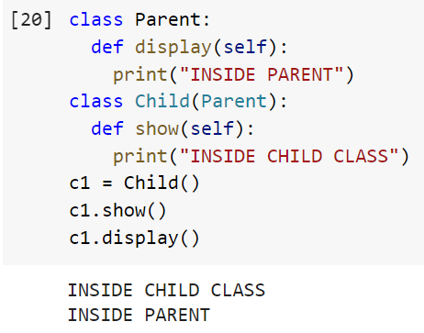
Inheritance (Cont.)
Single Inheritance:
Base Class
Parent
Child
Derived Class

Slide 40
Inheritance (Cont.)
In multiple inheritance, the features of all the base classes are inherited into the derived class.
The syntax for multiple inheritance is similar to single inheritance.
The multiderived class inherits the properties of both class base1 and base2
Base Class
Base 1
Base Class
Base 2
Multiderived Class
Base1 + Base2+ MultiDerived

Slide 41
Inheritance (Cont.)
Syntax :
class Base1:
pass
class Base2:
pass
class Multiderived(Base1,Base2):
pass

Slide 42
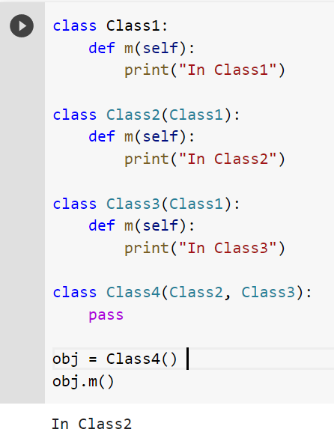
Inheritance (Cont.)
When you call obj.m() (m on the instance of Class4) the output is In Class2.
If Class4 is declared as Class4(Class3, Class2) then the output of obj.m() will be In Class3.

Slide 43
Inheritance (Cont.)
In multilevel inheritance, features of the base class and the derived class is inherited into the new derived class.
Base Class
Base
Derived Class 1
Base + Derived 1
Derived Class 2
Base + Derived 1 + Derived 2

Slide 44
Inheritance (Cont.)
Syntax :
class Base:
pass
class Derived1(Base):
pass
class Derived2(Derived1):
pass
Here, Derived1 is derived from Base, and Derived2 is derived from Derived1.

Slide 45
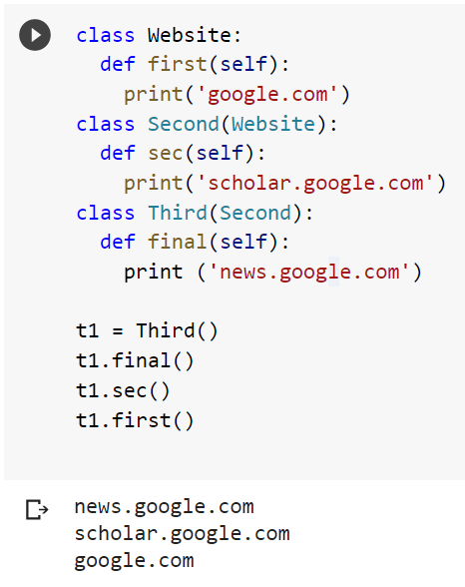
Inheritance (Cont.)

Slide 46
Inheritance (Cont.)
Hierarchical Inheritance: When more than one derived classes are created from a single base this type of inheritance is called hierarchical inheritance.
Base Class
Derived Class1
Derived Class2
Derived Class3

Slide 47
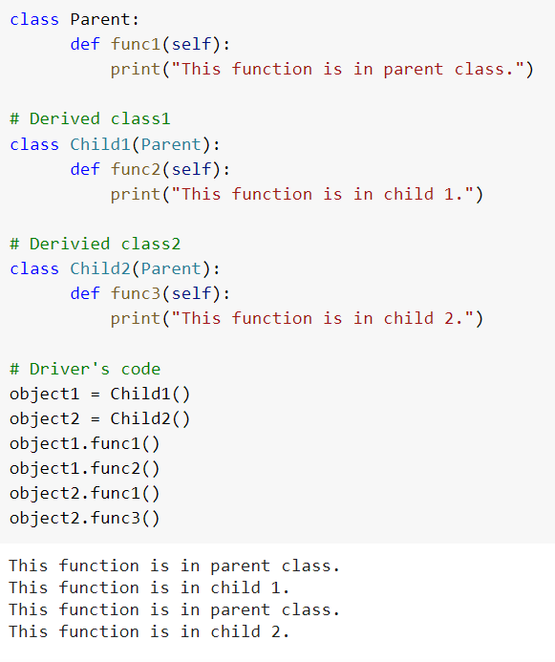
Inheritance (Cont.)
In this program, we have a parent (base) class and two child (derived) classes.

Slide 48
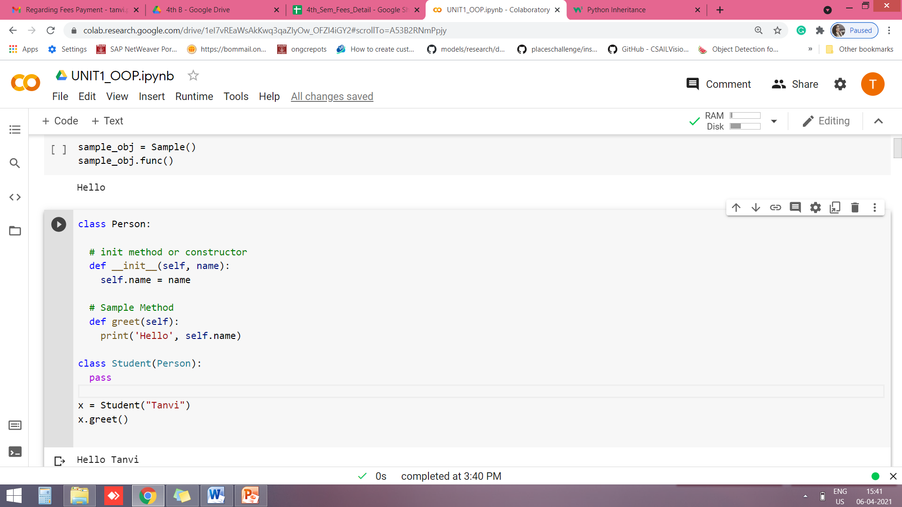
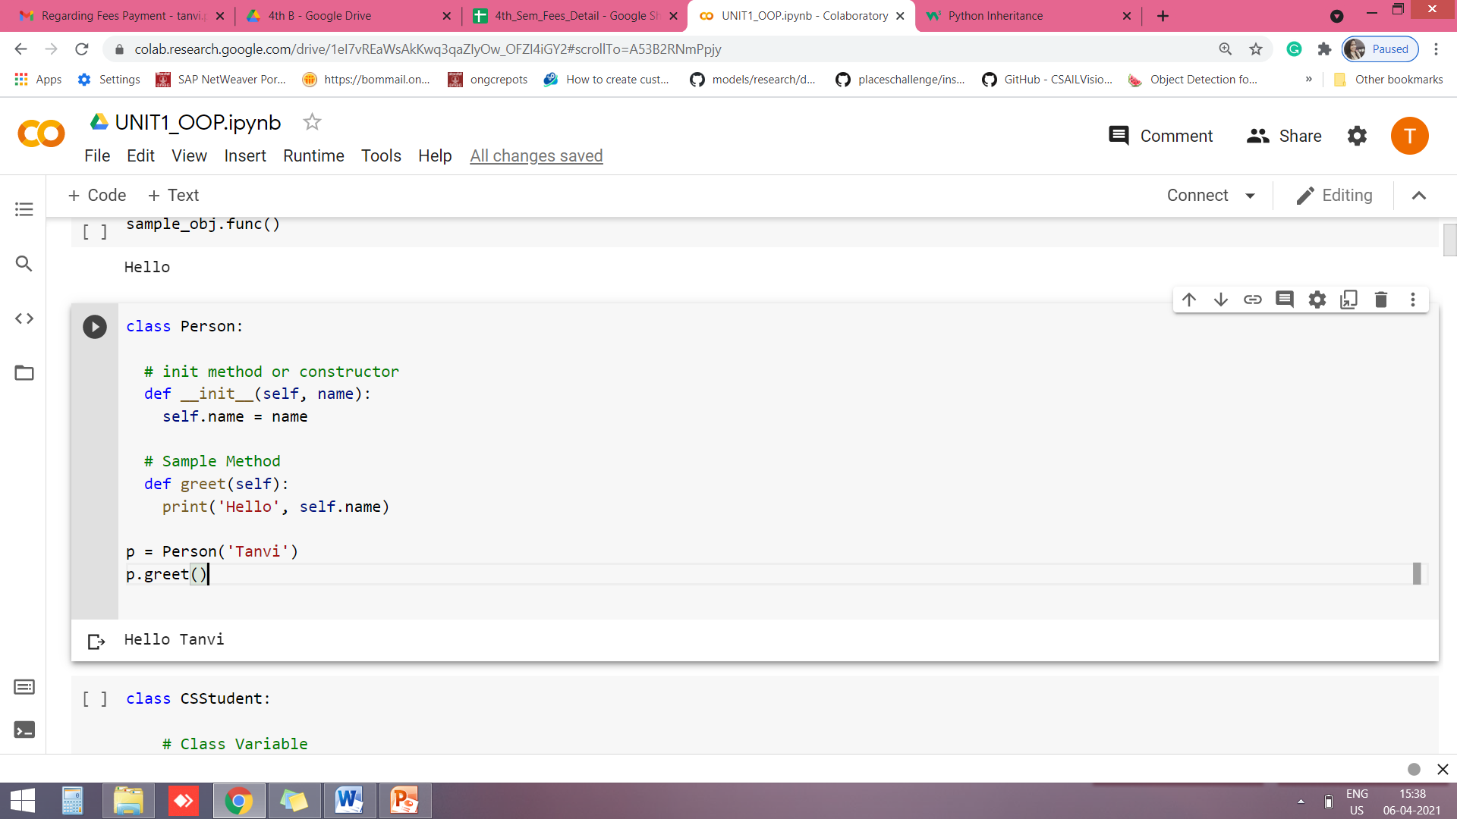
Inheritance (Cont.)
Parent Class
Any class can be a parent class, so the syntax is the same as creating any other class.
Parent and Child class:

Slide 49
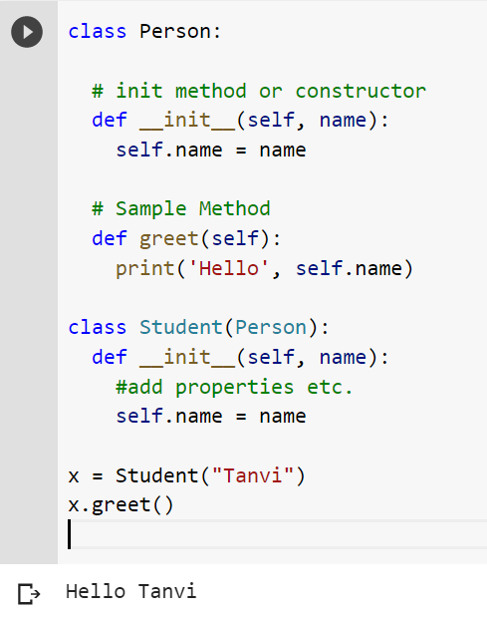
Inheritance (Cont.)
Add the __init__() Function
So far we have created a child class that inherits the properties and methods from its parent.
We want to add the __init__() function to the child class (instead of the pass keyword)
Note: The __init__() function is called automatically every time the class is being used to create a new object.

Slide 50
Inheritance (Cont.)
Add the __init__() Function
When you add the __init__() function, the child class will no longer inherit the parent's __init__() function.
Note: The child's __init__() function overrides the inheritance of the parent's __init__() function.
To keep the inheritance of the parent's __init__() function, add a call to the parent's __init__() function.

Slide 51
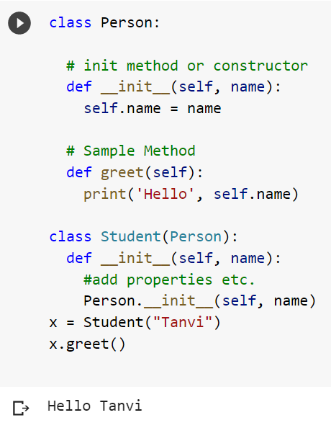
Inheritance (Cont.)

Slide 52
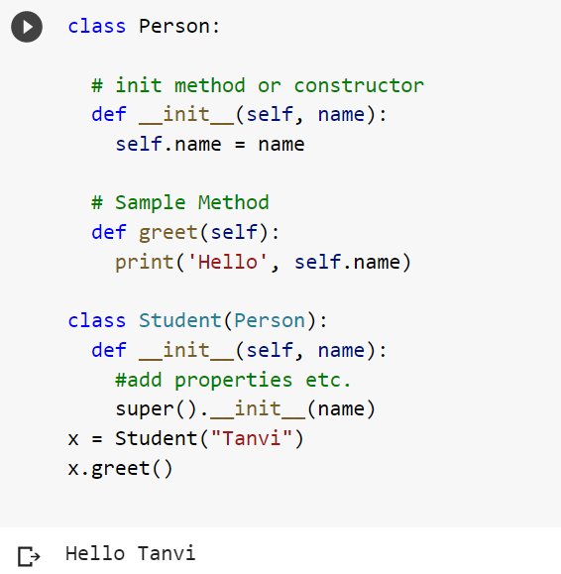
Inheritance (Cont.)
Use the super() Function
Python also has a super() function that will make the child class inherit all the methods and properties from its parent class.
By using the super() function, you do not have to use the name of the parent element, it will automatically inherit the methods and properties from its parent.

Slide 53
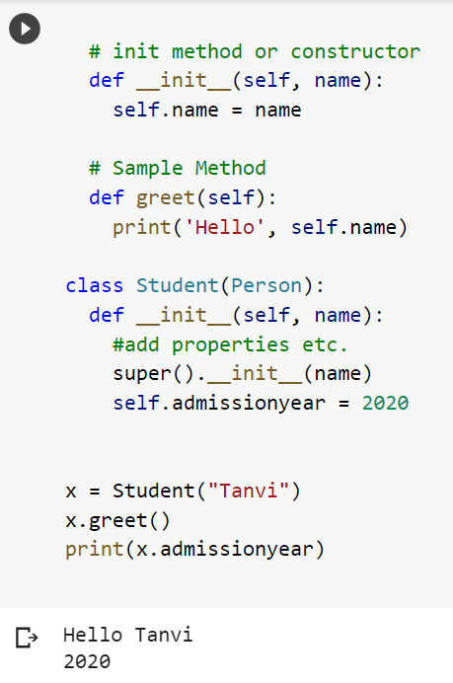
Inheritance (Cont.)

Slide 54
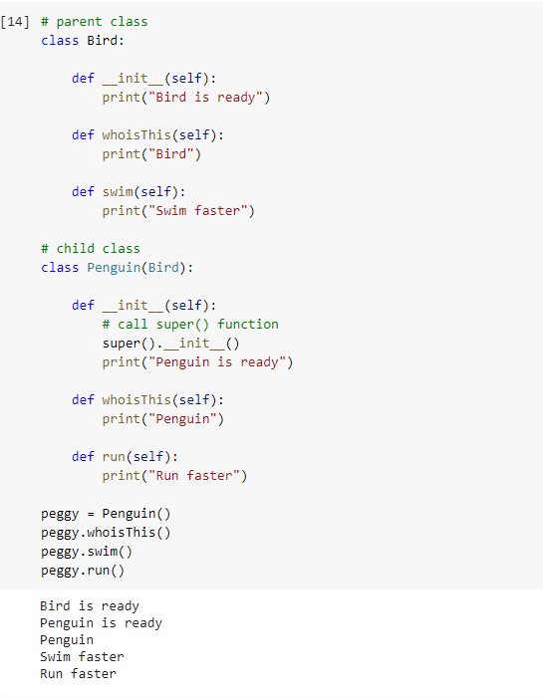
Inheritance (Cont.)
In the program, we created two classes i.e. Bird (parent class) and Penguin (child class). The child class inherits the functions of parent class. We can see this from the swim() method.
Again, the child class modified the behavior of the parent class. We can see this from the whoisThis() method. Furthermore, we extend the functions of the parent class, by creating a new run() method.
Additionally, we use the super() function inside the __init__() method. This allows us to run the __init__() method of the parent class inside the child class.

Slide 55
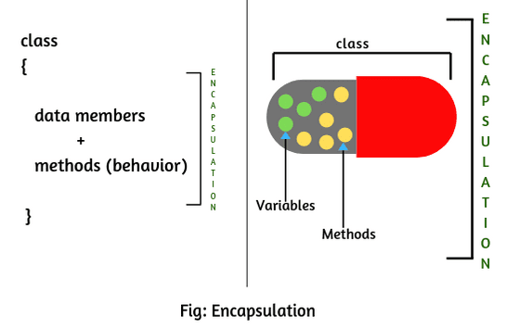
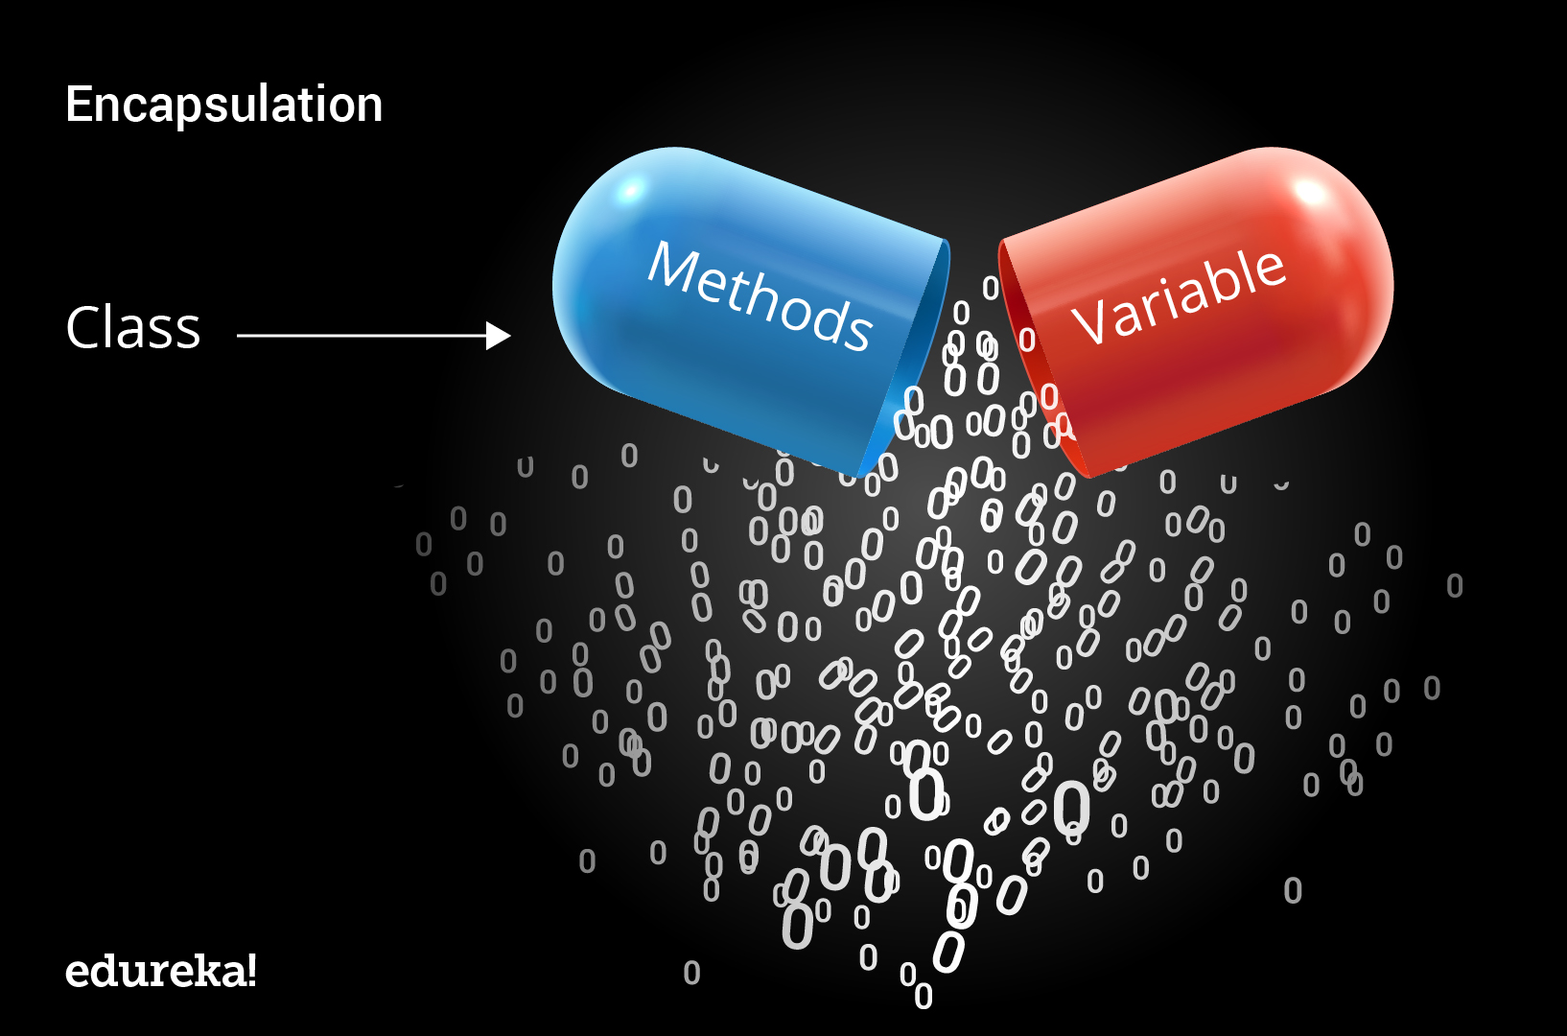
Encapsulation
Encapsulation describes the idea of wrapping data and the methods that work on data within one unit.

Slide 56
Encapsulation (Cont.)
It puts restrictions on accessing variables and methods directly and can prevent the accidental modification of data.
To prevent accidental change, an object’s variable can only be changed by an object’s method. Those types of variables are known as private variable.
A class is an example of encapsulation as it encapsulates all the data that is member functions, variables, etc.
Using OOP in Python, we can restrict access to methods and variables.
This prevents data from direct modification which is called encapsulation.
It acts as a protective shield that puts restrictions on accessing variables and methods directly, and can prevent accidental or unauthorized modification of data.

Slide 57
Encapsulation (Cont.)
Access modifiers
Access modifiers limit access to the variables and functions of a class. Python uses three types of access modifiers.
They are - private, public and protected.
Public members
Public members are accessible anywhere from the class. All the member variables of the class are by default public.

Slide 58
Encapsulation (Cont.)
Protected members
Protected members (in C++ and JAVA) are those members of the class that cannot be accessed outside the class but can be accessed from within the class and its subclasses.
To accomplish this in Python, just follow the convention by prefixing the name of the member by a single underscore “_”.

Slide 59
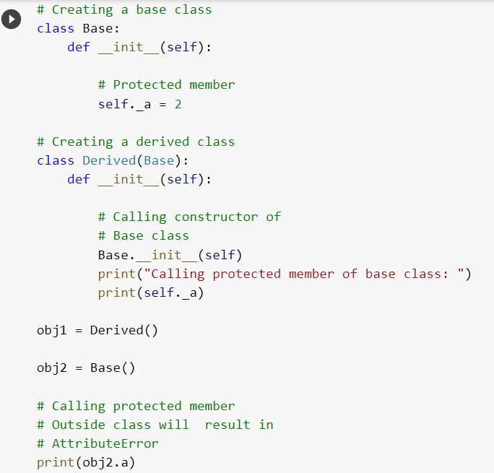
Encapsulation (Cont.)

Slide 60
Encapsulation (Cont.)
Private members
Private members are similar to protected members, the difference is that the class members declared private should neither be accessed outside the class nor by any derived class.
However, to define a private member prefix the member name with double underscore “__”.

Slide 61
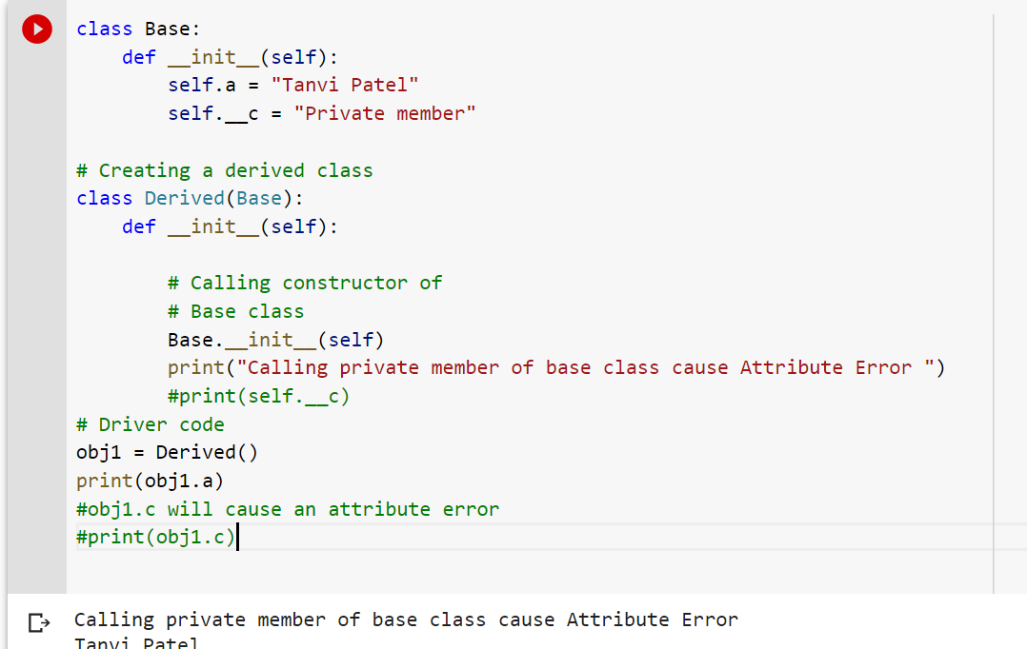
Encapsulation (Cont.)

Slide 62
Encapsulation (Cont.)
Getters and setters
Private variables are intended to be changed using getter and setter methods. These provide indirect access to them.

Slide 63
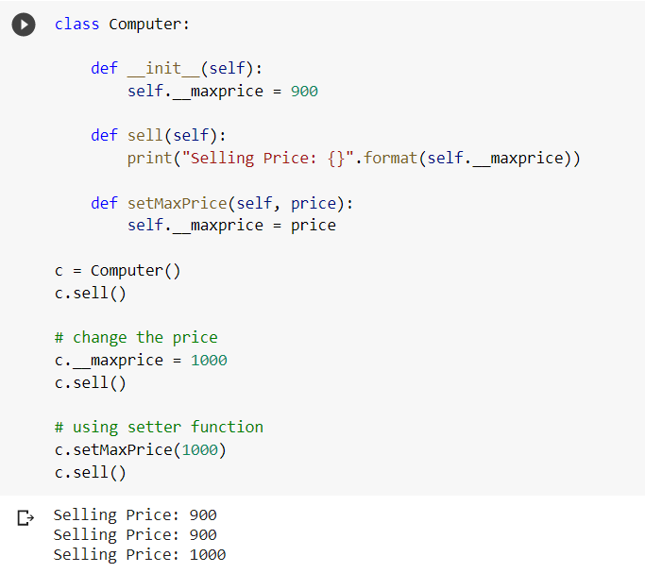
Encapsulation (Cont.)
In this program, we defined a Computer class.
We used __init__() method to store the maximum selling price of Computer. We tried to modify the price. However, we can't change it because Python treats the __maxprice as private attributes.
As shown, to change the value, we have to use a setter function i.e setMaxPrice() which takes price as a parameter.

Slide 64
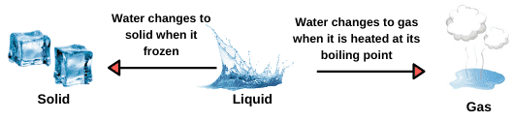
Polymorphism
Polymorphism is a Greek term which means ability to take more than one form.
Example1: If you learned driving one car, you’ll be able to drive any car, it doesn’t depend on car brand or inner implementation. It has same interface.
Example 2: Water

Slide 65
Polymorphism (Cont.)
In programming, polymorphism means same function name (but different signatures) being uses for different types.
Suppose, we need to color a shape, there are multiple shape options (rectangle, square, circle).
However we could use the same method to color any shape. This concept is called Polymorphism.

Slide 66
Polymorphism (Cont.)
Operator Overloading
Python operators work for built-in classes. But the same operator behaves differently with different types. For example, the + operator will perform arithmetic addition on two numbers, merge two lists, or concatenate two strings.
This feature in Python that allows the same operator to have different meaning according to the context is called operator overloading.

Slide 67
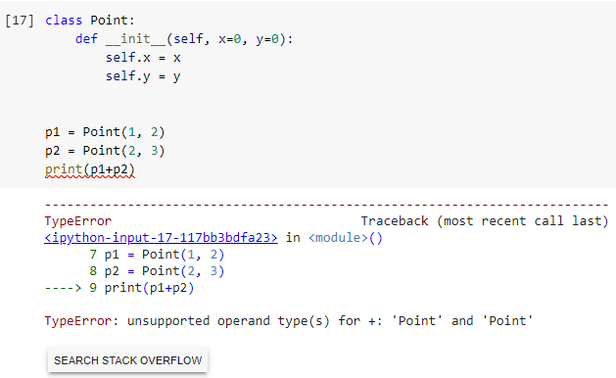
Polymorphism (Cont.)
Let us consider the following class, which tries to simulate a point in 2-D coordinate system.
Here, we can see that a TypeError was raised, since Python didn't know how to add two Point objects together.
However, we can achieve this task in Python through operator overloading.

Slide 68
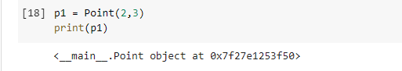
Polymorphism (Cont.)
Python Special Functions
Class functions that begin with double underscore __ are called special functions in Python.
These functions are not the typical functions that we define for a class. The __init__() function we defined above is one of them. It gets called every time we create a new object of that class.
Suppose we want the print() function to print the coordinates of the Point object instead of what we got.

Slide 69
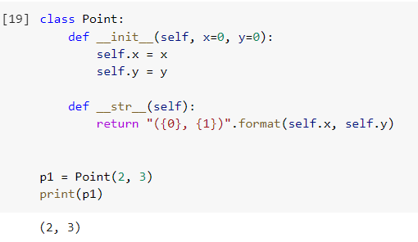
Polymorphism (Cont.)
We can define a __str__() method in our class that controls how the object gets printed.

Slide 70
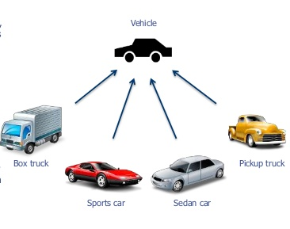
Abstraction
Here we have different types of trucks and cars. They have different color, shape, engine which makes them distinct.
But they have some common properties and behavior among them i.e., they all have tires, engine, steering, gear etc. and are used for travelling and can be operated in a common way.
Vehicle can be the general idea of a car or truck. It retains only the information on general vehicle attributes and behavior eliminating the other characteristics of a particular car or a truck.
Abstraction means hiding the implementation details and only show the essential details.

Slide 71
Conclusion
Object-Oriented Programming makes the program easy to understand as well as efficient.
Since the class is sharable, the code can be reused.
Data is safe and secure with data abstraction.
Polymorphism allows the same interface for different objects, so programmers can write efficient code.
Follows bottom up approach
This language also emphasizes reusability through inheritance and the capacity to spread current implementations without having to change a great deal of code by using polymorphism.

Slide 72
Thank You

